Slide 1


Capstone end-to-end deployment PROJECT commodity analysis hs-2 level
Submitted to:- Niharika Tewari
Submitted by:- Sonia Rikhi

Slide 2


overview
Problem Statement
Data Analysis
Data Pre-processing and Feature Engineering
Regression Models
Conclusion

Slide 3
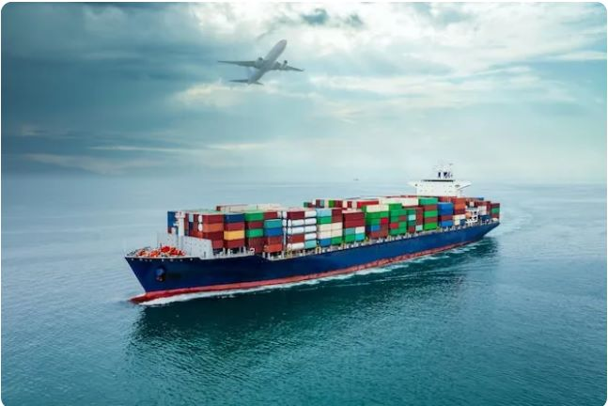
Problem statement:- commodity analysis hs2-level with foreign trade

Slide 4



PROBLEM STATEMENT(CONTINOUS)
DATASET:-
EXPORT DATASET
IMPORT DATASET
A few questions that can be answered using this dataset are:
What did India export the most in any given year?
Which commodity forms a major chunk of trade? Does it conform to theories of international trade?
How has the trade between India and any given country grown over time?

Slide 5
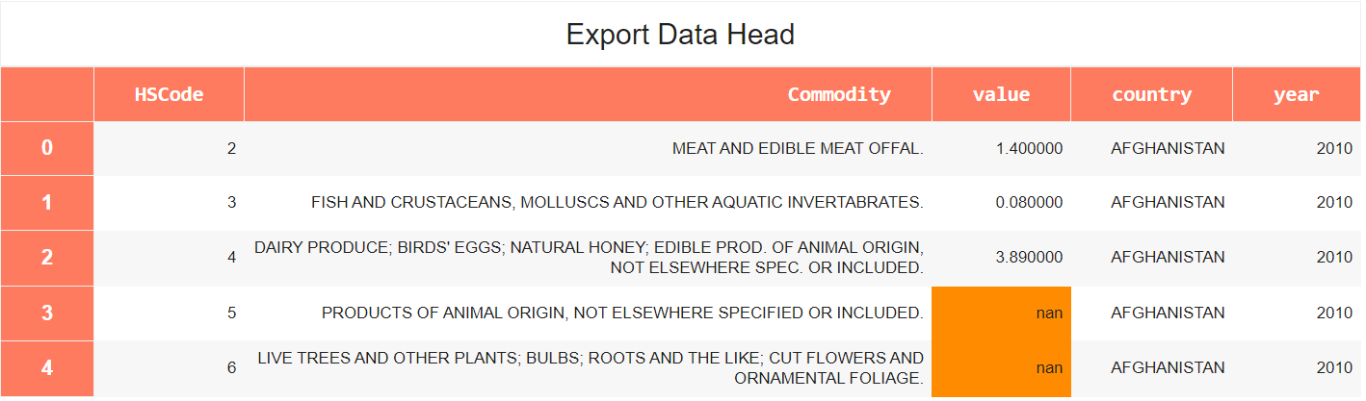
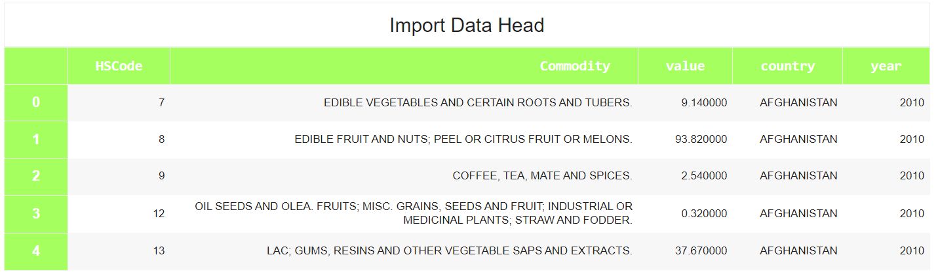
DATA analysis

Slide 6

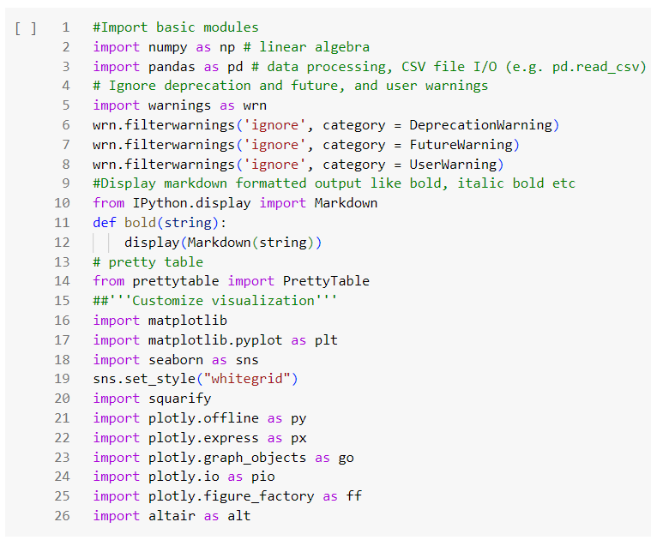
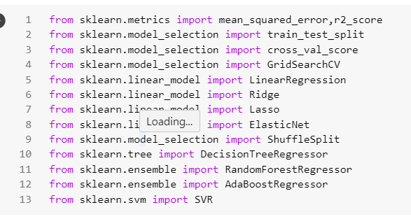

IMPORTANT LIBRARIES

Slide 7
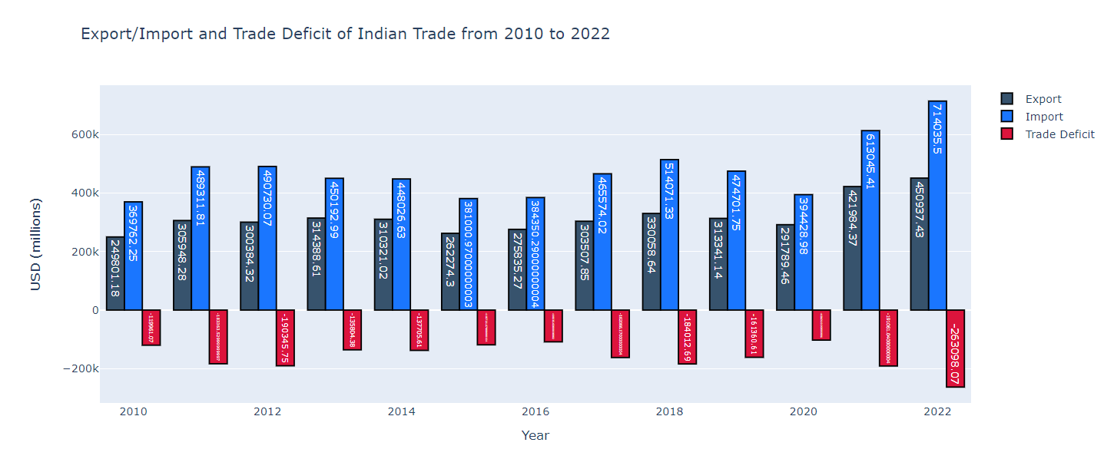
Data pre-processing and feature engineering

Slide 8
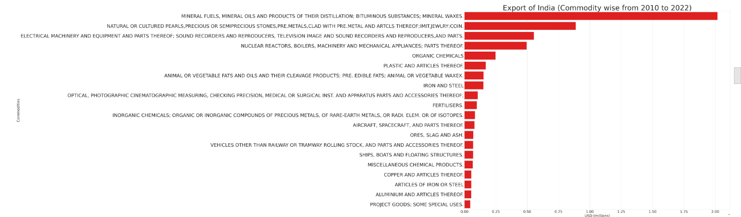
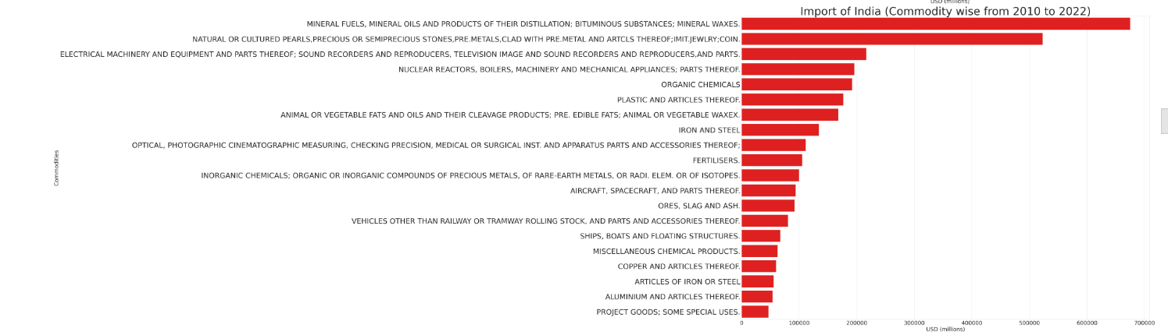

Slide 9
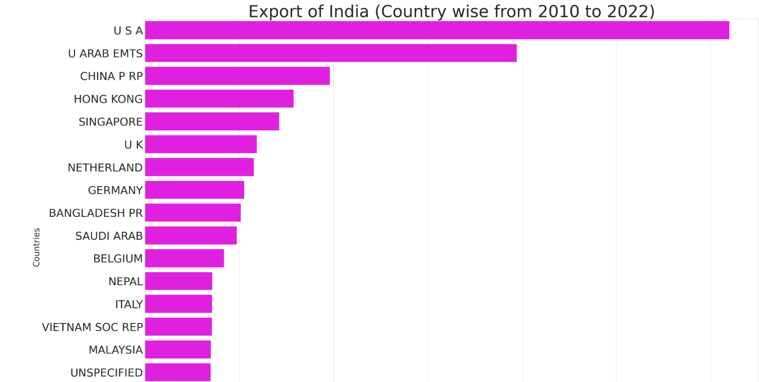
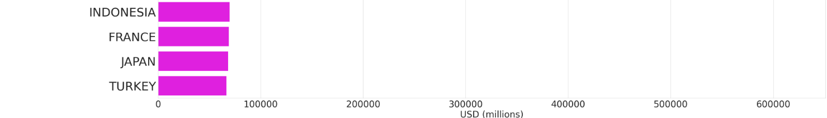

Slide 10
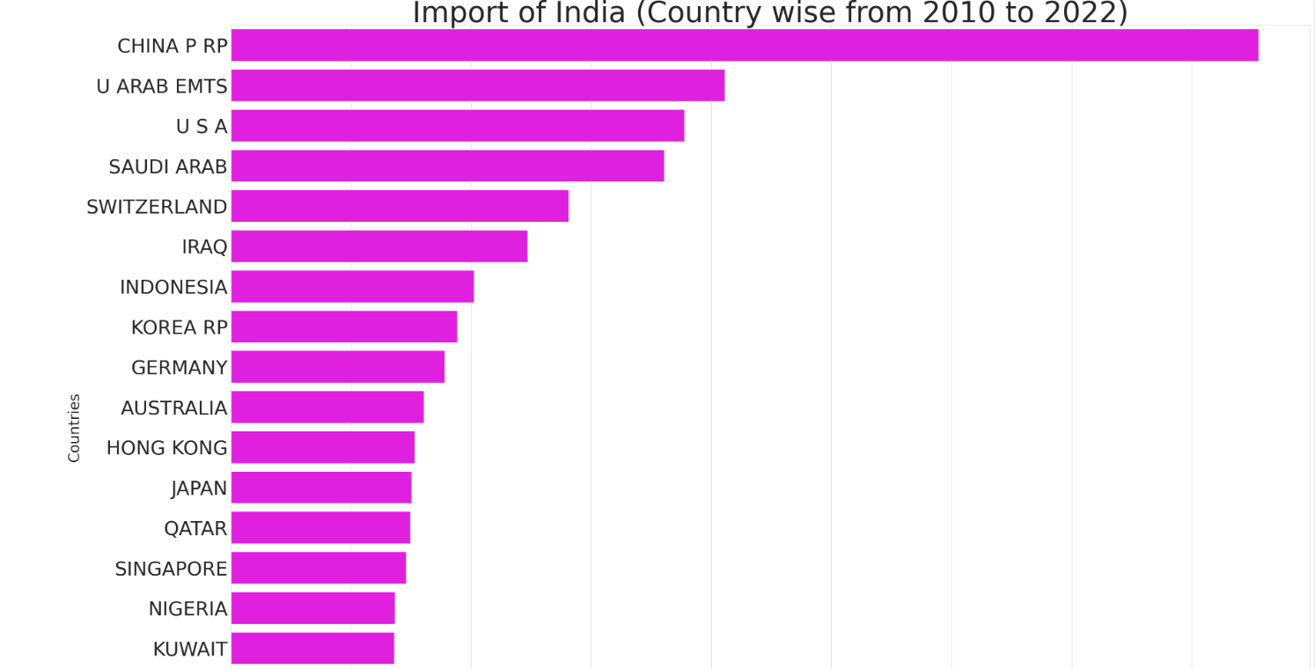
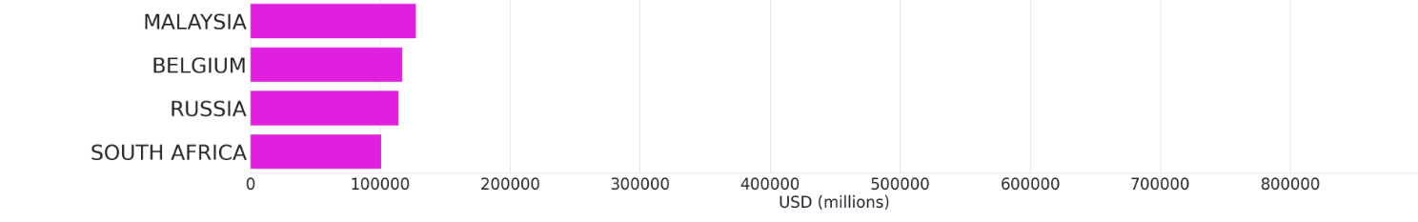

Slide 11

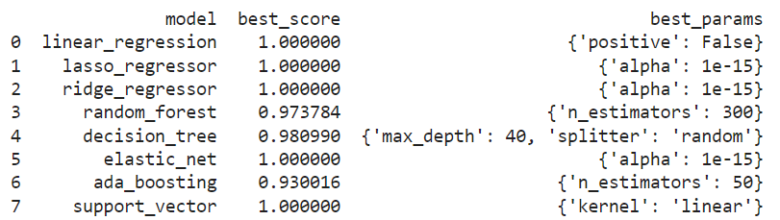
REGRESSION MODELS

Slide 12
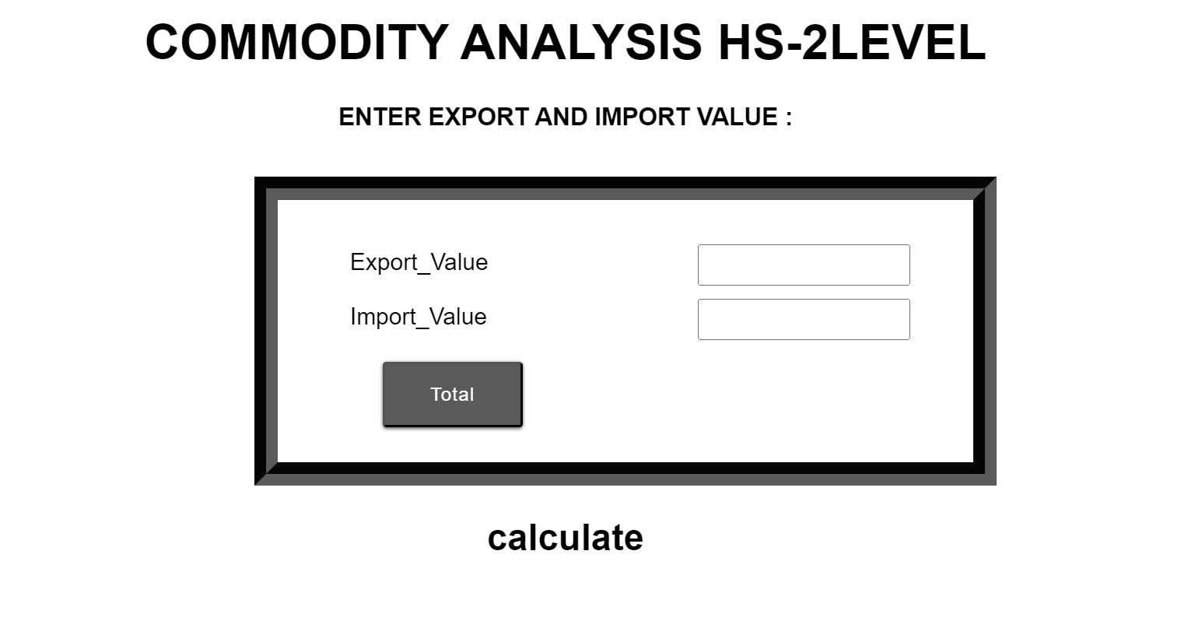
Link:- https://commodity-analysis-hs2-levels.onrender.com/

Slide 13


